Slide 1
IPUMS Time Use Workshop ASA 2019 annual conference
Sandra Hofferth, Maryland Population Research Center (MPRC)
Liana Sayer, Professor of Sociology & Director,
Maryland Time Use
Notes:
Ask everyone to sign in with email so we can send presentation & links to exercises & evaluation

Slide 2
Objectives
Sections of the Presentation:
Develop familiarity with the breadth and depth of data available through IPUMS Time Use
Assess the appropriateness of the American Time Use survey (ATUS), the American Heritage Time Use surveys (AHTUS), and Multinational Time Use surveys (MTUS) for specific research topics
Learn how to navigate the IPUMS Time Use web-based extract system and create custom extracts that include user-defined time use variables
Notes:
This workshop aims to promote awareness of and expertise in the IPUMS Time Use data archive. IPUMS Time Use archive consists of three integrated databases: the American Time Use Survey (ATUS-X), the American Heritage Time Use Study (AHTUS-X), and the Multinational Time Use Study (MTUS-X).
This archive makes large U.S. and international databases with detailed data on time use more easily accessible to researchers. By combining data over time and across countries and enriching information available across household members, this project facilitates research on how time use influences the health of families and individuals, how household health behaviors respond to changing conditions, and how health and well-being differ across cultural and policy settings.
The IPUMS Time Use Project facilitates user access to data from respondent, household, and time diary activity files and simplifies the production of a data file suitable for analysis. It allows researchers to select study populations; to create measures of time in user-defined activity aggregations, and broken out by time of day, by location, by whether the respondent was engaged in caring for children during the activity or was engaged in eating or drinking during the activity, and by the presence or absence of specified others; and, to request customized data files in in a variety of formats. Free, downloadable datasets come with SAS, SPSS, and Stata command files, which include variable and value labels for ease of use. IPUMS Time Use also provides researchers with accessible and comprehensive online documentation. The workshop will provide an overview of the web-based data access and documentation system, a brief overview of influential literature that uses time diary data, and a hands-on demonstration of the IPUMS Time Use data extraction system (for example, see www.atusdata.org). Workshop participants will have access to several hands-on exercises and will be provided information about online resources. Workshop demonstrations will be provided for novice and more experienced users of the IPUMS time use archive

Slide 3
Part 1: Learn about the IPUMS Time Use Archives
ATUS, AHTUS, MTUS

Slide 4
IPUMS
Acronym for Integrated Public Use Microdata Series. Now just “IPUMS”
Developed by the University of Minnesota and archived there
Originally concentrated on census/survey data for the U.S. and other nations
Now includes time use data in a similar web-based system

Slide 5
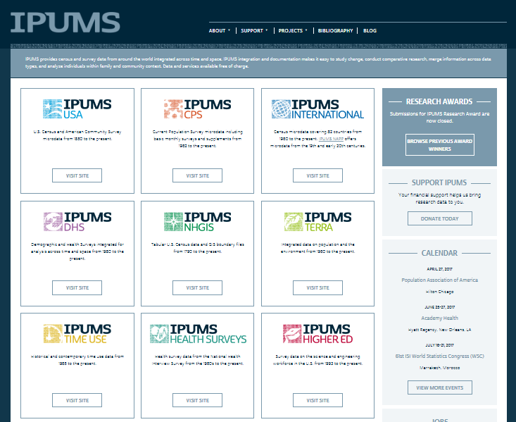
http://www.ipums.org/
Notes:
IPUMS Time Use is part of a suite of IPUMS projects at the University of Minnesota
IPUMS stands for: Integrated Public Use Microdata Series
However, it is now just “IPUMS”
Developed by the University of Minnesota and archived at the University of Minnesota
Originally contained census data for the U.S. and other nations
Now has time use data in a similar web-based system

Slide 6
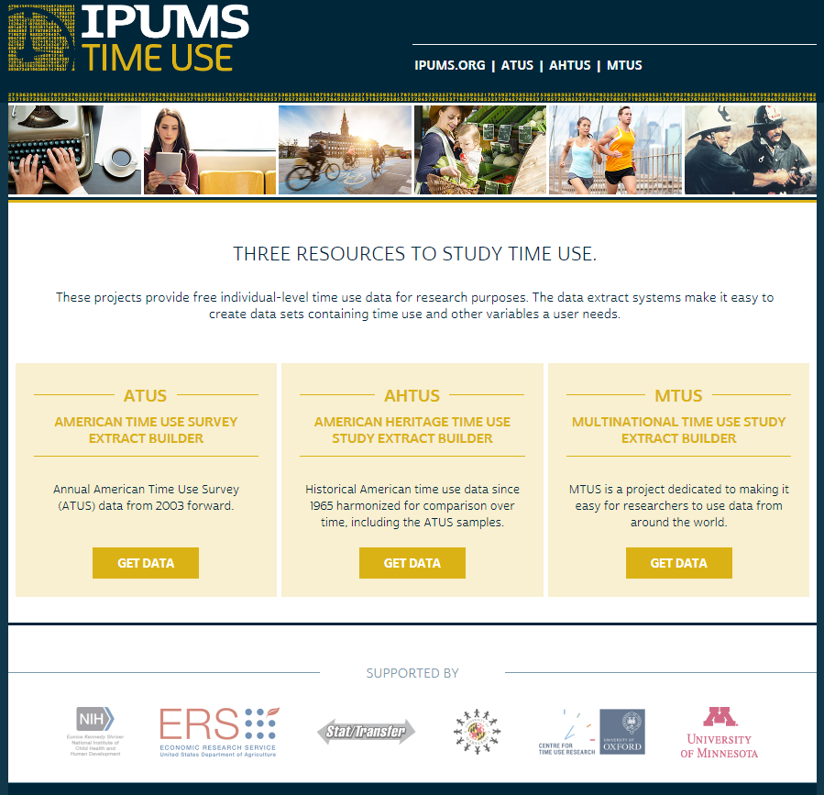
Notes:
IPUMS Time Use consists of three databases. They all provide access to time diary data, but are harmonized differently.

Slide 7
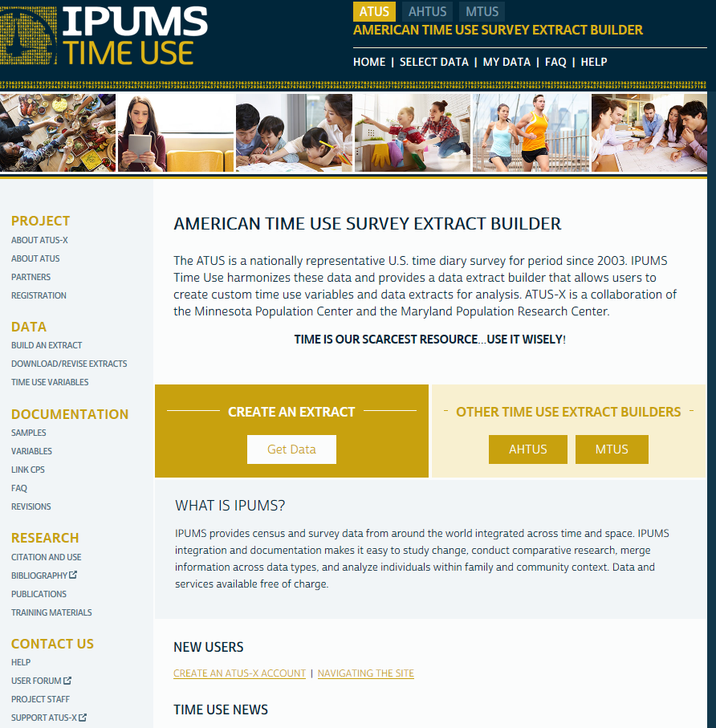

Slide 8
IPUMS Time Use Registration
Click on “Registration”
Log in with your IPUMS account information
Or
Apply for access: fill out form to register for access
Can explore data archive without an account but cannot save variables or an extract

Slide 9
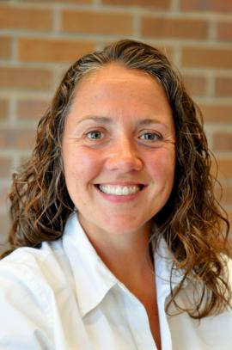
IPUMS Time Use Team
University of Maryland & Maryland Population Research Center
University College London, Centre for Time Use Research
University of Minnesota & Minnesota Population Center
Sandra Hofferth
Margarita Vega Rapun
Sarah Flood
Liana Sayer
Jonathan Gershuny
Dan Backman

Slide 10
Web-Based Data Access System
Why use IPUMS Time Use archive (ATUS-X, AHTUS-X, MTUS-X)?
Lowers barriers to access – much is done for the user behind the scenes so you don’t have to
Lowers learning time – everything in one place
Simplifies use of complex time diary data
What does it deliver? Customized data set with
Years of data and countries you want
Data harmonized across time and countries
Variables you care about and defined the way you want
User-defined measures of time in specific activity aggregations
Dataset and variable-level documentation in one place and connected to your variables, plus variable-level frequencies
Data in multiple formats (SAS, STATA, SPSS)
Email helpline: ipums@umn.edu
Notes:
Powerful web-based interface allows creation of customized, easy-to-use data extracts & user-defined measures of time in specific activity aggregations

Slide 11
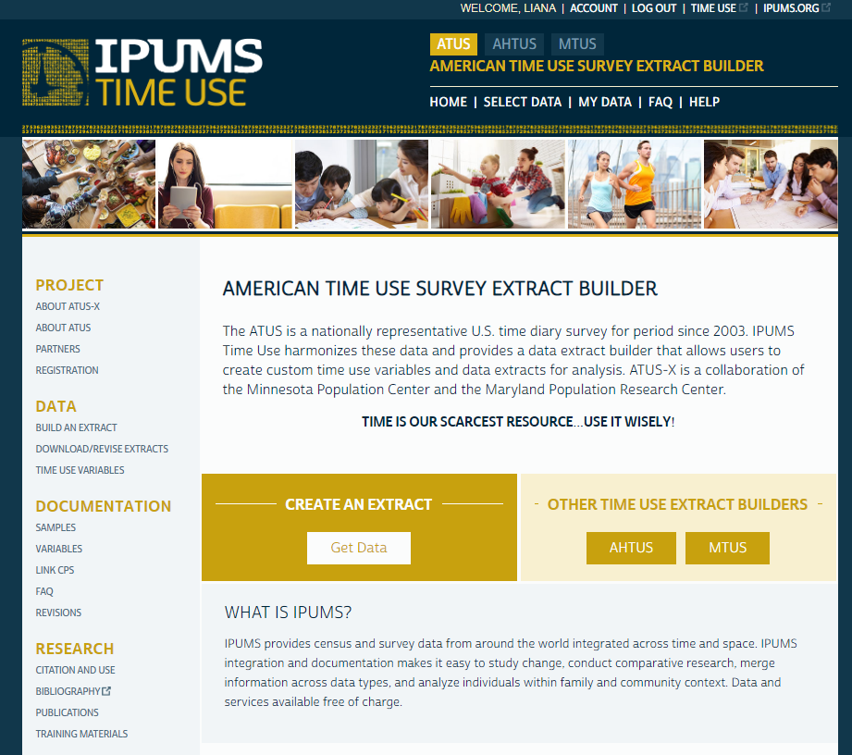

Slide 12
ATUS - X
Data from the American Time Use Survey from 2003 to the present
Survey of persons age 15 and older interviewed with a 20-minute computer-assisted interview conducted by telephone by the U.S. Census Bureau for the Bureau of Labor Statistics
Annual data released in summer each year
Occasional supplements with focused items:
Eating and Health, Well-Being, Leave, Elder Care

Slide 15
Types of People
ATUS respondents
Time diary data for one 24-hour period
Last month of CPS data
Updates from CPS
Members of ATUS respondent households
Last month of CPS data
Updates from CPS
ATUS non-respondents
Survey methodology questions
Last month of CPS data
Members of ATUS non-respondent households
Last month of CPS data
NOTE: not only time use, but data from two time points for a large number of variables!
Back
Notes:
Select sample.
Module are NOT available for all the years
Select 2006 and 2012

Slide 16
ATUS versus CPS Variables
In most cases, CPS variables indicated by _CPS8:
ATUS interview variables: AGEYCHILD, RELATE
Final CPS interview variables (2-5 months prior to ATUS interview): AGEYCHILD_CPS8, RELATE_CPS8
Not all information updated during ATUS interview
In cases where information is not updated and is unlikely to have changed, we generally do not append _CPS8 to the variable name
e.g. RACE, MARST, others
Quick shortcut to determine whether an individual was in the household at the time of ATUS, CPS, or both: PRESENCE
CPSIDP – Unique longitudinal CPS identifier on both ATUS and CPS
https://www.atusdata.org/atus/cpslink.shtml
Back
Notes:
Variables collected in CPS are indicated _CPS8
Click in the variable to see the information displayed.
Descrption
Comparability
Universe
Code, frequencies, by respondents

Slide 17
CPS Supplements Variation year to year
January: Displaced worker
March: Annual Social/economic (ASEC)
May: Disability
June: Fertility
August: Veterans
September: Volunteering*
October: School Enrollment*
November: Voting/Computing
December: Food security*
* example on IPUMS web site

Slide 19
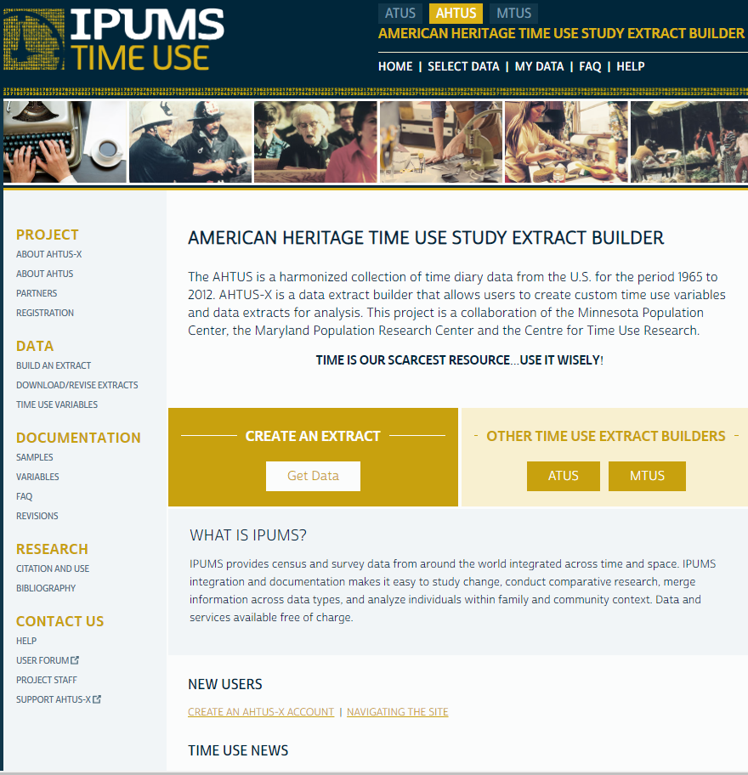
Notes:
The American Heritage Time Use Study, a database of harmonized historical national time-diary samples collected over six decades, includes harmonized background, activity, location, mode of transport and who else was present variables.
First released in October 2015
Data included:
1965-1966 The Multinational Comparative Time-Budget Research Project
1975 American's Use of Time: Time Use in Economic and Social Accounts
1985 American's Use of Time Project
1992-1994 National Human Activity Pattern Survey
1998-2001 Family Interaction, Social Capital, and Trends in Time Use Study and National Survey of Parents
American Time Use Survey 2003-2012

Slide 20
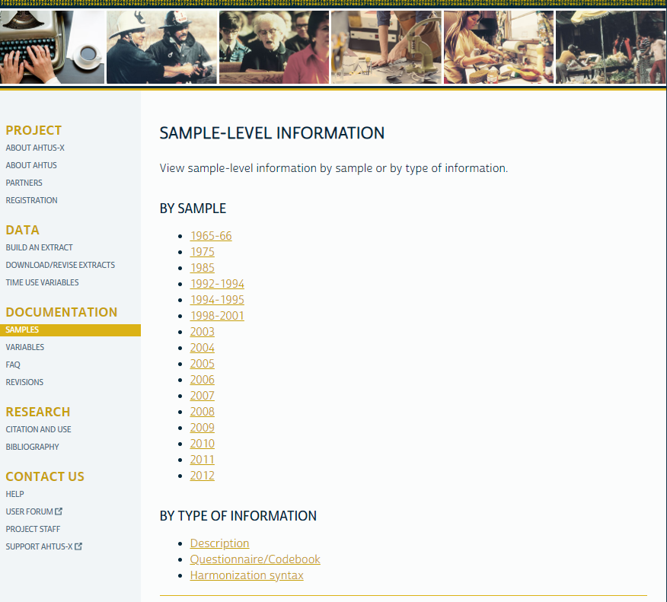

Slide 21
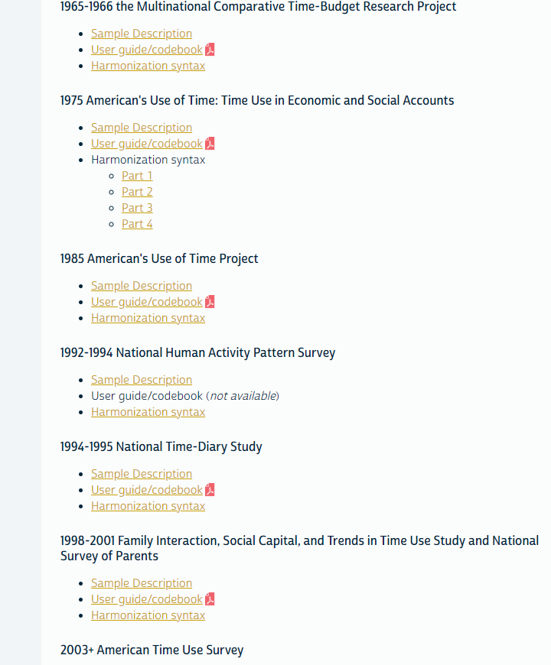

Slide 22
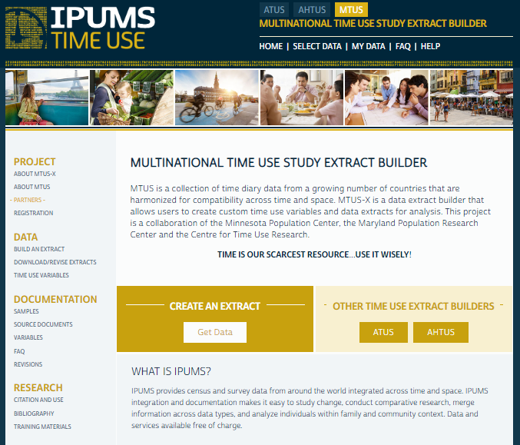
Notes:
Multinational Time use Study Extract Builder (MTUS-X)
International data on time use available in partnership with the Centre for Time Use Research, UCL
Useful for comparative policy research across western European nations at the moment

Slide 23
Centre for Time Use Research, UCL
Identifies time use data sets
Acquires data
Harmonizes data
Disseminates data in MTUS on the CTUR web site and via MTUS-X
CTUR: https://www.timeuse.org/
Notes:
Topics covered: contracts, confidentiality, translations, limitations to dissemination

Slide 24
Currently Available via MTUS - X (Multiple waves)
Austria
Bulgaria
Canada
Finland
France
Hungary
Israel
Italy
Netherlands
Spain
United Kingdom
United States

Slide 25
Planned Additions to MTUS - X
Brazil
Germany
India
Mexico
South Africa (2)- 2019
South Korea (3)- 2019
Turkey

Slide 26
Harmonization
From Businessdictionary.com:
Adjustment of differences and inconsistencies among different measurements, methods, procedures, schedules, specifications, or systems to make them uniform or mutually compatible.

Slide 27
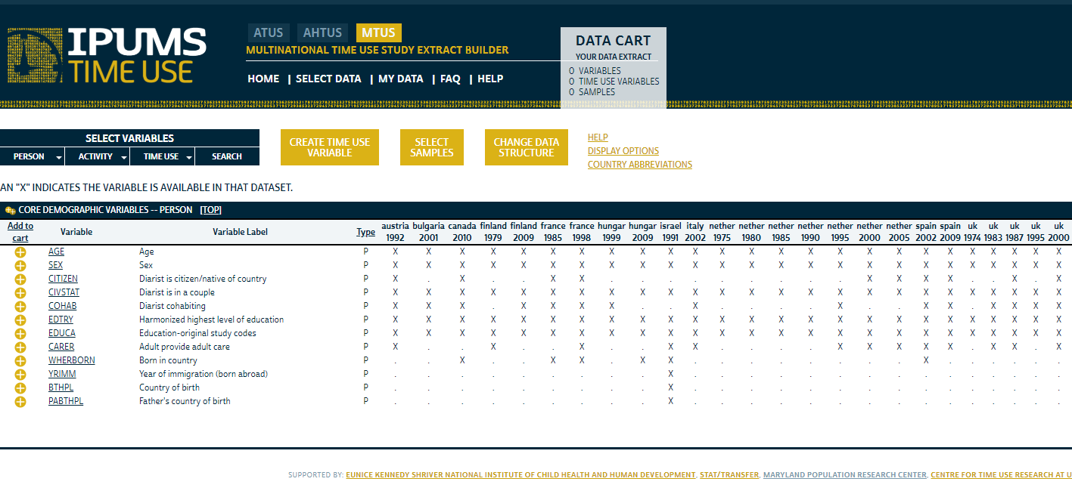

Slide 28
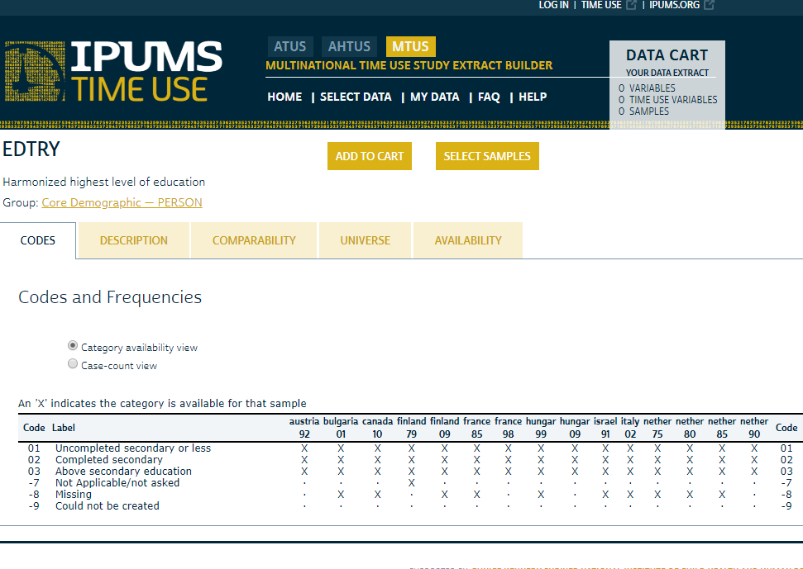

Slide 29
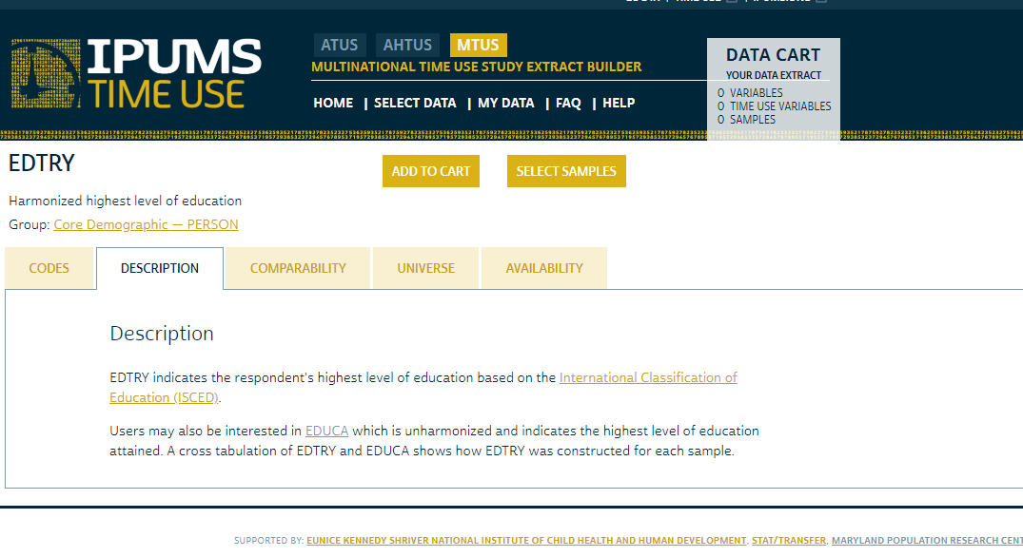

Slide 30
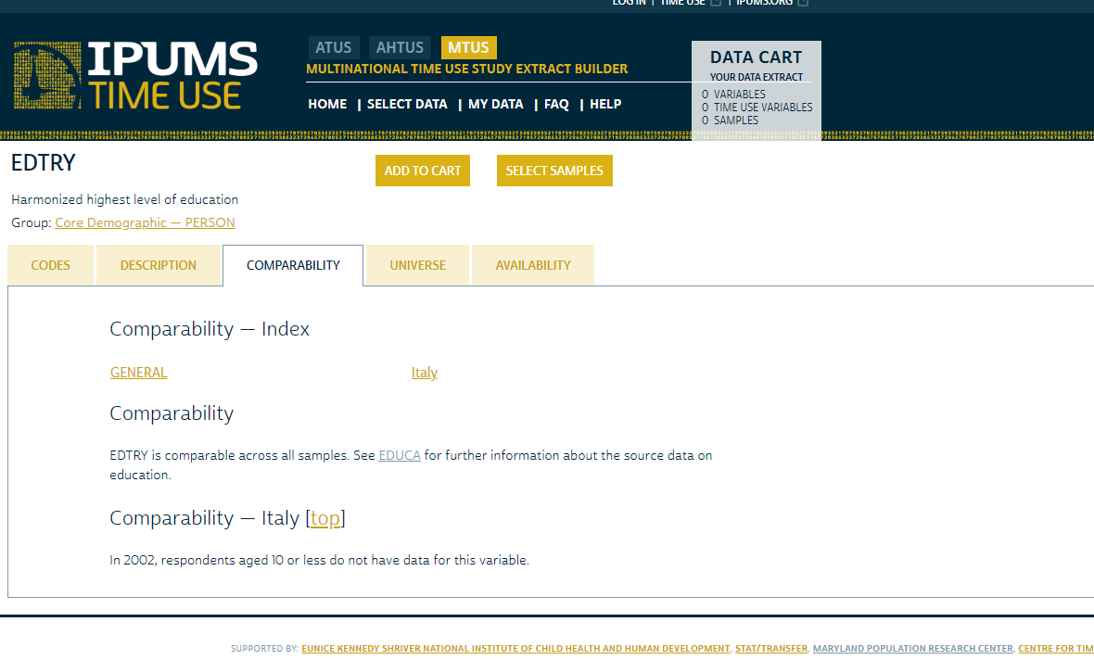

Slide 31
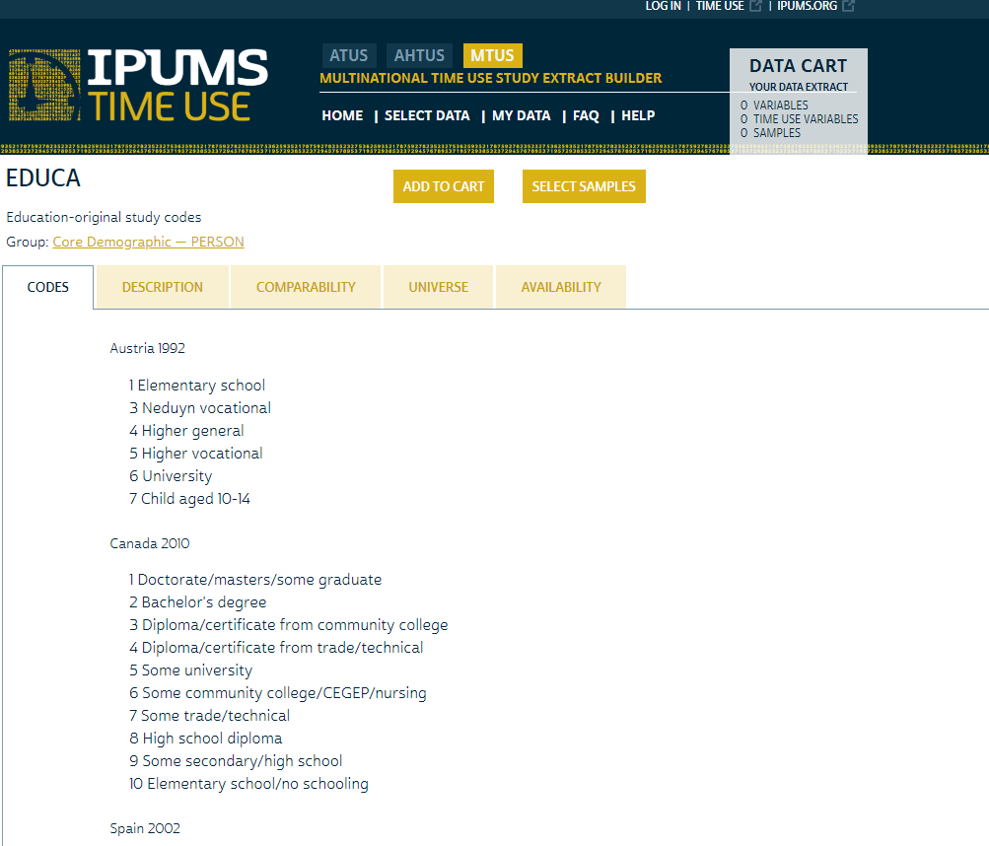

Slide 32
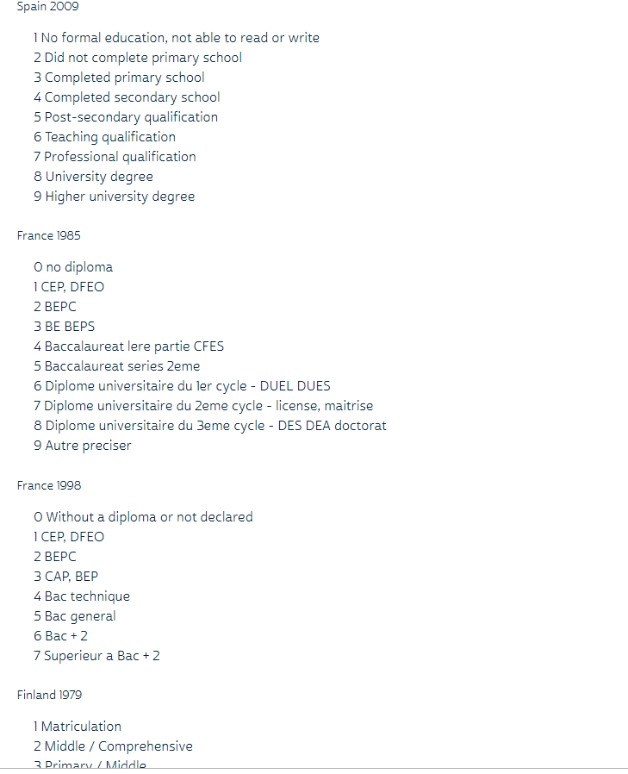

Slide 33
QUESTIONS?

Slide 34
Part 2: Select a Topic and Archive for Your Research
ATUS-X, AHTUS-X, MTUS-X
Notes:
The focus of part 2 is to:
Provide an overview of the assumptions and applications of time use reseach
Provide information about the meaning and construction of time use variables
Provide an overview of the differences across the ATUS-X, AHTUS-X, and MTUS-X designed to help you, the researcher, determine the appropriateness of each of the three archives for your specific research topic

Slide 35
Assumptions of Time Diary Research
Daily behavior the “sociological atom” of social research (Jonathan Gershuny, CTUR)
All activities by all groups of people are worthy topics of research
Comprehensive behavioral data essential to understand complex social issues
Comprehensive behavioral data essential to understand policy influences on social change
Notes:
Time use research begins with some key conceptual assumptions
Core assumption is insight of time use researchers, described so well by Jonathan Gershuny at CTUR, that daily behaviour is the “sociological atom” of research
Data allow researchers to examine breadth of daily activities, motivated by the assumption that all activities by all groups of people are important topics of research
With time diary data on daily routines, researchers can study activities and groups that have been overlooked in prior research – show some select topics of research in a few slides
Another assumption is that to understand behaviour must examine activity patterns more comprehensively –
Focus on isolated types of behaviour distorts, obscures relationships between activities, groups, outcomes
Time diary data more accurate & reliable – what people think they do and what they actually do differs
Thus,
Must have data on all types of activities individuals do to obtain the comprehensive overview of behaviour necessary to advance understanding of complex societal issues
Last, is the assumption that time diary data is necessary to advance understanding of the complex interrelationships of policy on behavioural change
Since time diaries collect data on all activities across the day – systems of behaviour – can study how behaviour changes more comprehensively.
Consider unintended behavioural changes as well as intended behavioural changes
Policy-related aspects of Time Use Research is broad, as shown in the next slide

Slide 36
Policy Applications of Time Use Research

Slide 37
Selected Research Topics
Leisure (trends, physical activity, quality)
Sleep (hours per week, deprivation, trends)
Health (associations with activities)
Subjective well-being
Eating
Work-life Balance
Paid work (hours of work, scheduling)
Unpaid work (women’s total economic contribution, hours, trends, sharing in households)
Adult care (valuation, time cost, who performs care but does not identify as a carer)
Child care (valuation, trends, participation of fathers, balance of physical/interactive care)
Volunteering / civic engagement (valuation, trends)
Education (homework, parental involvement)
Environment (transport modes, time at home/inside)
Notes:
This slide shows selected research questions that have been investigated by time use scholars
Topics underscore one benefit of time diary data
Allows reseachers to examine activity patterns more comprehensively – and thus advance understanding of determinants and outcomes of individual behaviors but also how
Daily activities & routines of one person are embedded in web of social relationships, networks, so what one does influences what other people do
And time diary data reveal interrelationships of paid work, housework, care work, and leisure – and implications for work / life “balance”
Sustainability of lifestyles, etc….

Slide 38
What is a time use variable?
Number of minutes per day (0-1440) in specific activities
Summarize time across the day based on
Primary and secondary activities
Location
Time of day
With others
More restrictions = fewer people who will have done the activity given the constraints
Notes:
Now that we know why to use time diary data, how can we think about the measures that are constructed from the diaries
Time use variables are user-defined combinations of activities and/or filters that create measures of the number of minutes respondents spend during the 24-hour reference period in activities matching the specified criteria.
You can create your own time use variables in IPUMS Time Use data access system by selecting the primary activities of interest and restricting them to certain secondary activities, locations, times of day, and the presence of others.
Examples:
Socializing & supervising children
Watching television at home with family members
Activities done while commuting home from work
Leisure activities with friends

Slide 39
Creating Time Use Variables
Researchers
Custom time use variables
Low barrier to creating with complex activity-based variables
System
Background manipulation of diary data to construct time use variables
Outputs either rectangular or hierarchical data files
Saves custom variables & extracts
Notes:
To summarize, IPUMS Time Use facilitates your ability – as researchers – to easily construct custom time use variables without you – the researcher – needing expertise in complex programming skills (e.g. this is the barrier)
The complex manipulations of the data are done by the IPUMS Time Use system
Products can be delivered in format most appropriate for your research question
Segue –
Ok, so now you have an idea of what time use variables are and how to construct custom time use variables
Let’s now consider how researchers determine which archive can / should be used for their research

Slide 40
Archive Differences
Activity classification system
400+ codes in ATUS
98 codes in AHTUS
69 codes in MTUS
Sampling frames
ATUS
One diary day from one individual age 15 or older selected from CPS household in ATUS
AHTUS
One diary day from one individual aged 18 and older in AHTUS
Subsample of 1975 data have diaries from spouses
MTUS
Weekend and weekday diaries in some countries
Diaries from all household members in some countries
See here
Notes:
This slide presents two of the basic differences across the ATUS, AHTUS, and MTUS – detail in activity coding and the individuals and diary days included in the study
All have detailed time diary activity records but the level of granularity in coding specific activities varies substantially
ATUS: most detail 400+
AHTUS: 98 codes
MTUS: 69 codes
In AHTUS and MTUS some detail collapsed from the verbatim accounts of daily life provided in the diaries to allow for harmonization of activity codes across time and across space
The sampling frame – or individuals and diary days that provide diaries – also differs
ATUS: one diary day from one individual
AHTUS: one diary day from one individual
With one caveat 1975 subsample does have spouse diaries because the survey was part of a larger omnibus data collection project
MTUS – substantial variation across countries included in the archive –
GO TO MTUS-X
To summarize
When determining which archive to use, consider the level of detail in activity classification AND if you need individual or household data and/or diary data from one day or for multiple days

Slide 41
Health Related Variable Differences
ATUS
Self-Reported Health
Physical Activity
Life Satisfaction & Momentary Affect
MET Value
AHTUS
Disability
No measure of general health
MTUS
General Health
Rushed
Disability
Notes:
The archives also differ
in the types of questions they include in the individual and household surveys
And in their inclusion of contextual or constructed variables on the diary
This slide shows some of the differences in the types of health variables available across the 3 archives. Don’t have time to go through all of this, so will focus on key distinctions
ATUS has 4 different measures of health
Self-reported health, available Eating & Health Module 2006-2008 & 2014-2016
2010-2013 part of Well-Being Module
Physical Activity – collected in 2014-2016 Eating & Health Module
Indicator (yes/no) of exercise done in past 7 days
Life Satisfaction & Momentary Affect available from 2010, 2012-2013 Well-Being Modules
Life satisfaction – WBLADDER or life satisfaction ladder, also known as Cantrell Ladder, indicates respondents subjective evaluation of where they are at present relative to the worst or best possible life for them
Momentary Affect – positive and negative emotions experienced in 3 randomly selected activities reported on the diary day,
MET value that represents the average metabolic equivalency value associated with an activity, available all years of ATUS
AHTUS is most limited with an indicator of whether the person has a disability but no other questions about health.
ATUS also has question about mobility limiting disability and standard CPS labor force status variable that indicates employment limiting disability
MTUS – more similar to ATUS, but at this point no METS data
Self-reported health available in select countries
See availability in documentation
General question on rushed, again in some select countries, but no data on emotions experienced in specific activities

Slide 42
Time Diary Archive Differences
Secondary activity data
ATUS
Secondary Child Care
Secondary Eldercare
Secondary Eating & Drinking
AHTUS
SEC
MTUS
SEC
Notes:
Archives also differ in extent the diaries measure multitasking --- or activities that are done simultaneously with other activities
Known as secondary activity data
ATUS
ATUS collects only secondary child care (defined as having a child in one's care while engaged in another activity), secondary eldercare (defined as having an elder person in one's care while engaged in another activity), and secondary eating and drinking (collected as part of the Eating and Health module fielded from 2006 to 2008),
No other information on secondary activities available
AHTUS
Has secondary data for all activities and thus the secondary data is not comparable to ATUS secondary data
MTUS
Has secondary data but not for all surveys

Slide 43
Time Diary Archive Differences
With Whom
ATUS
WHO_ASK
Technical Who Variables (hierarchical)
Create Own Time Use Variable (rectangular)
AHTUS
Who else is present during activity
Who Variable Availability Grid
MTUS
https://www.mtusdata.org/mtus-action/samples
Who else is present during activity
Notes:
The last difference we’ll discuss today is the “with whom” data – this is data that indicates the absence or presence of other individuals during the activity
Archives differ in activities asked about and level of detail for individuals present during the activity
ATUS
WHO_ASK Some activities don’t have who data – sleeping, grooming, personal activities, refusal/Don’t know
ATUS provides most detail on the relationship of the person, and also their age and sex
This is in the Technical Who Variables – require output of hierarchical data, one record per activity for each person
All archives provide indicator variables for presence of specific individuals
Spouse/partner
Children
Other adults
No one else present
All allow custom time use variables that indicate time with specific individuals in specific activities

Slide 44
MTUS-X
International data
Varies: One to
Multiple
1965-present
Varies: Individuals, Couples & Households
AHTUS-X
Historical - Present US data
98
1965-present
12 (with plans to add more)
69
ATUS-X
US data
2003-present
400+
One
One Respondent Per Household
Momentary Affect; METS
Temporal Coverage
Geographical Scope
IPUMS Time Use
Number of Countries
1 (US)
1 (US)
Number of Diary Days
Varies: One to
Multiple
Household Coverage
Varies: Individuals & Couples
Number of Activity Codes
Additional Diary Features
Use of Devices
--
Multitasking
Varies: Limited to Detailed
Varies: Limited to Detailed
Limited
Additional Survey Features
Health, Time Pressure
--
Health, Life Satisfaction, Poverty
Notes:
Decision tree is visual representation of differences across the archives
This handy visualization can help you determine which of three archives is best suited for your research topic

Slide 45
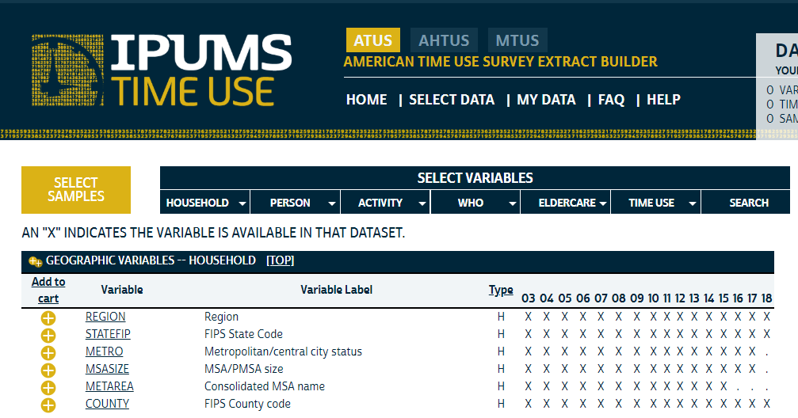
Archive Differences: ATUS Geographic Variables

Slide 46
ATUS Geographic Variables: State

Slide 47
ATUS Geographic Variables: Region

Slide 48
ATUS Geographic Variables: Metro

Slide 49
ATUS Geographic Variables: MSA Size

Slide 50
ATUS Geographic Variables: Met Area

Slide 51
ATUS Geographic Variables: County

Slide 52
AHTUS Geographic Variables

Slide 53
MTUS Geographic Variables: Region

Slide 54
MTUS Geographic Variables: Urban

Slide 55
QUESTIONS?

Slide 56
Part 3: Create a Custom Extract: Time Spent in Physical Activity and Health
Exercise 7 in handout
Notes:
We have prepared a set of exercises to help familiarize you with the IPUMS time use website and get you started using MTUS-X data. there are a set of paper copies available as well as a link to the pdf version of the file under “training materials” on our website. Please work through the exercises that you find most relevant. We will be avaiable to help you as you work through them at your own pace.
We will take specific questions now. After the Q&A we will also be available for 1:1 consultations.

Slide 57
Online Demo
Logged in or finished registration
Selected topic and the archive to use
Viewed documentation
Create a time use variable
Add demographic variables
Make an extract
Download data
Create an analysis file
Get help

Slide 58
Health-Related Activity Measures
Physical Activity time
Specific Activity selected by a belief in its healthfulness (130100)
Mode of Transportation – self propelled or riding
An aspect of Paid & Unpaid work
According to MET values (ratio of metabolic rate per time unit during activity to resting rate),
categorized as moderate or vigorous
https://www.atusdata.org/atus-action/variables/group?id=a-tech
https://www.atusdata.org/atus-action/variables/METVALUE#description_section
https://epi.grants.cancer.gov/physical/MET/
Sedentary time (e.g., Relaxing, TV viewing) (120300)
Specific Activity selected by belief in its nonhealthfulness
Context
MET value (e.g., low MET)
Sleep time (010100)
Night time
Naps
Disturbed & disrupted sleep episodes
Notes:
Researchers define what work is.
MET values –Activities are classified by their MET (metabolic equivalent) value, which provides an estimate of the energy expended during an activity, per unit of time. It is expressed as the ratio of the metabolic rate during the activity to a standard resting metabolic rate of 1. Ainsworth and colleagues prepared a compendium that was used to assign METs to each activity in the ATUS.

Slide 59
Health Measures
Self-reported health – five category self-reported health (excellent, very good, good, fair, poor)
BMI – Body mass index, computed from height & weight
https://www.atusdata.org/atus-action/variables/group?id=demog

Slide 60
Exercise
Go to ASA Workshop Materials HERE:
https://www.atusdata.org/atus/ASA_workshop_2019.shtml
Exercise 7: “Estimates of Time spent in Physical Activity in ATUS Well-being Module”

Slide 61
Exercise 7: Estimates of Time spent in Physical Activity in ATUS
With time use data, physical activity can be defined in several ways. We will create different measures of physical activity and see how sensitive the measurement is to the patterns we observe in the data. Your objective in this exercise is to create time use variables from the ATUS activity-level data, to consider different ways to measure physical activity in the ATUS, and to explore associations between BMI, health, and physical activity.
The first step in the process is to create a dataset that contains only the respondents who participated in the Eating and Health Module of the ATUS (hint: use the module selection on the samples page to identify the years (6) in which the module was fielded). Make sure to include in your extract the BMI and general health status variables along with the appropriate weight to use when analyzing Eating and Health Module data (EHWT). Because we're going to create time use variables from the activity-level data, make sure your extract is hierarchical and you choose the necessary variables to construct time use variables based on mode of transportation, activity, and MET values associated with activities.

Slide 62
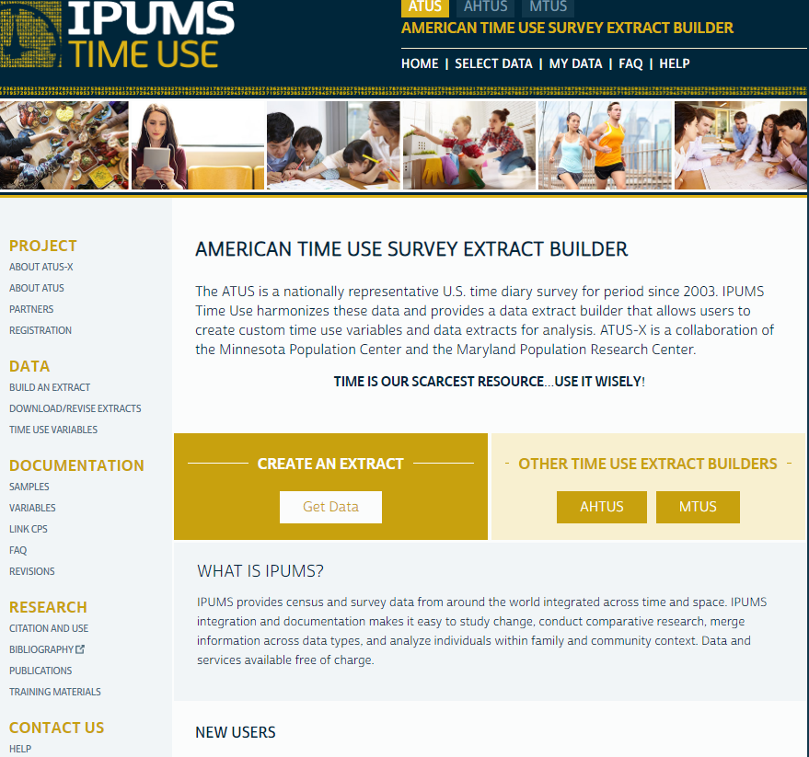

Slide 64
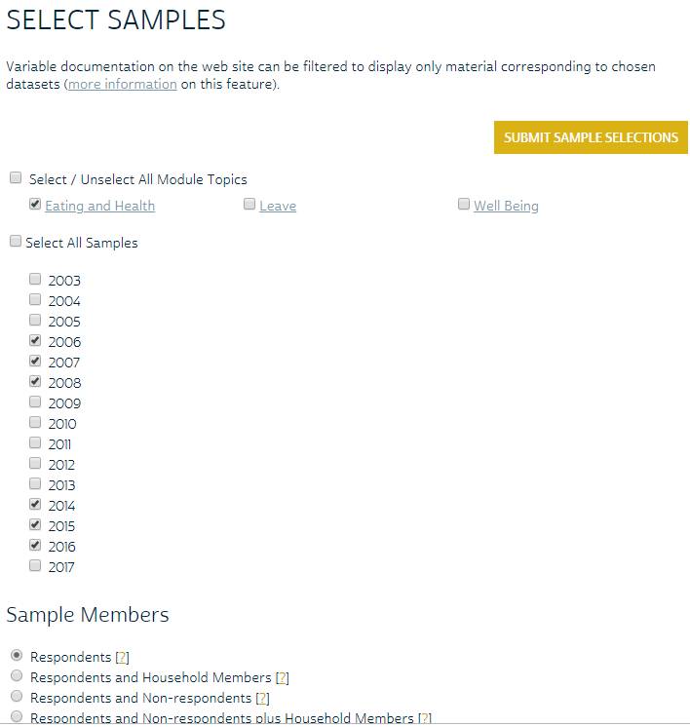

Slide 65
Caution
Will need to go back to the Select variables page after each selection (slide 28). That step is not included here to avoid duplication.

Slide 66
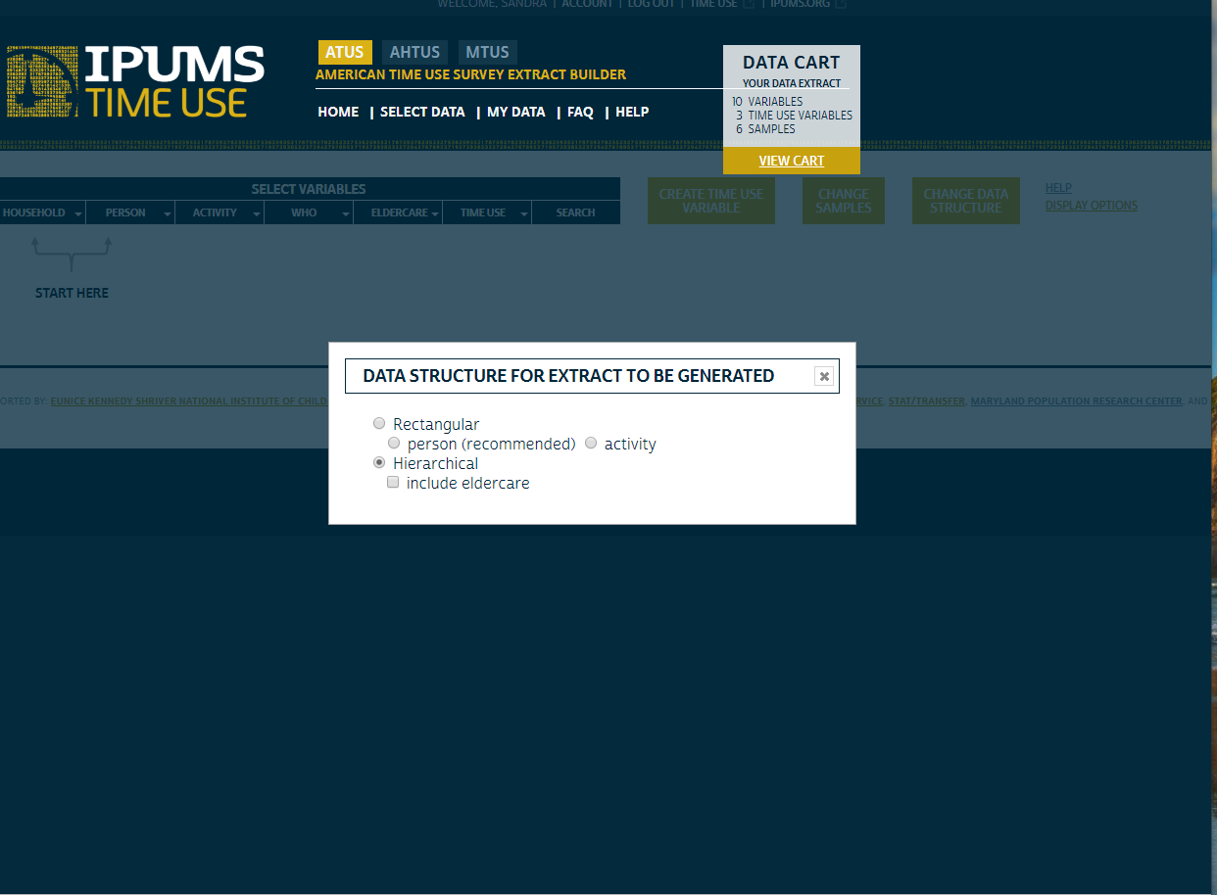

Slide 67
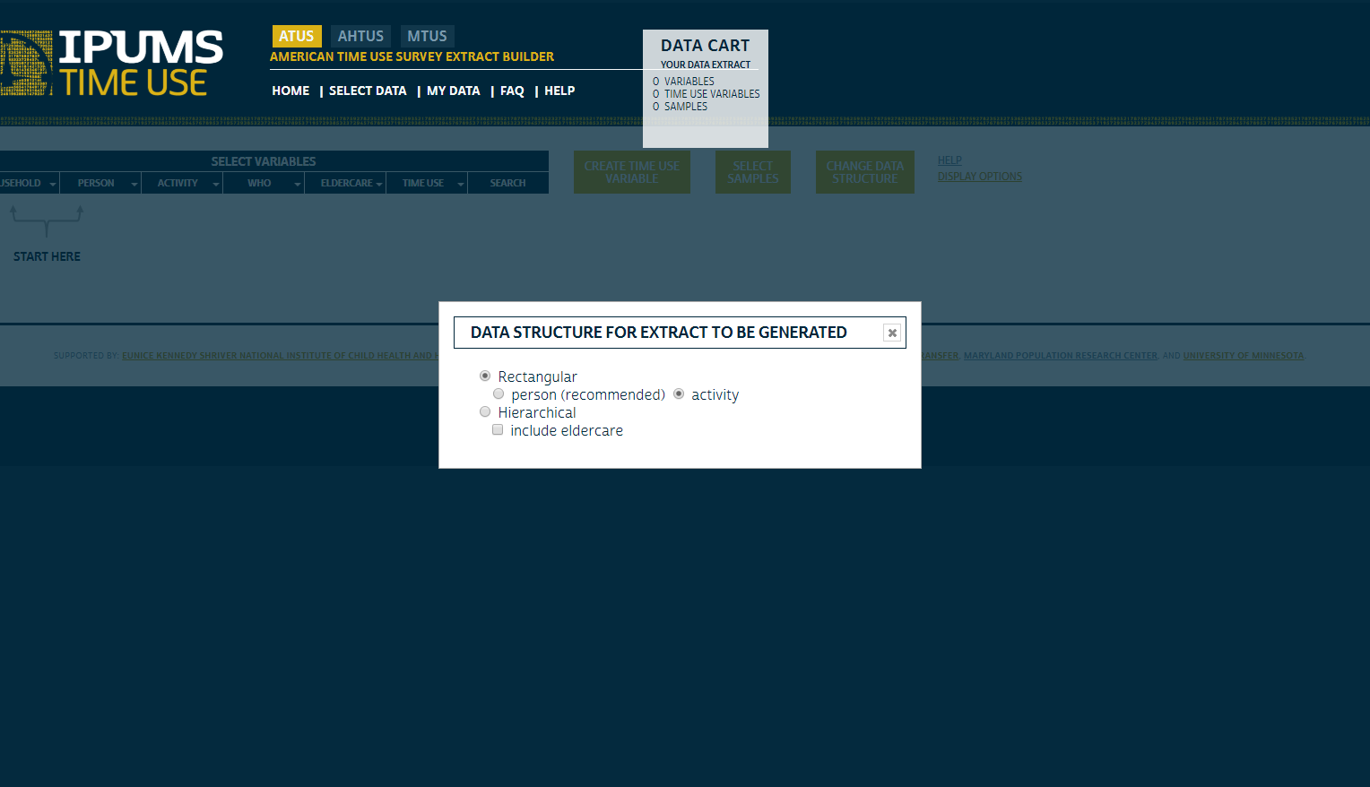

Slide 68
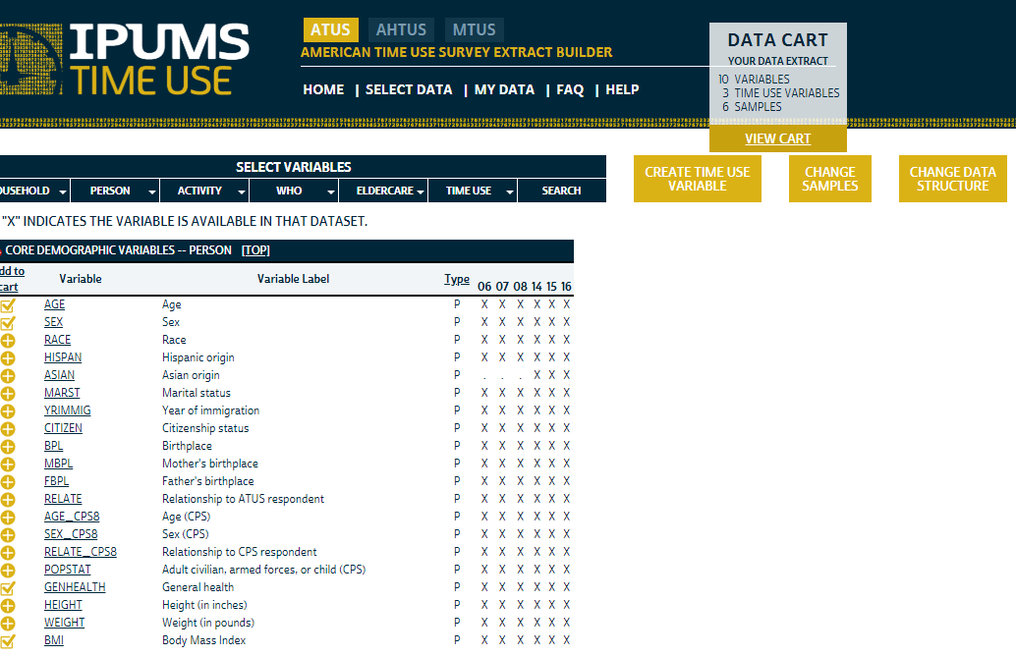

Slide 69
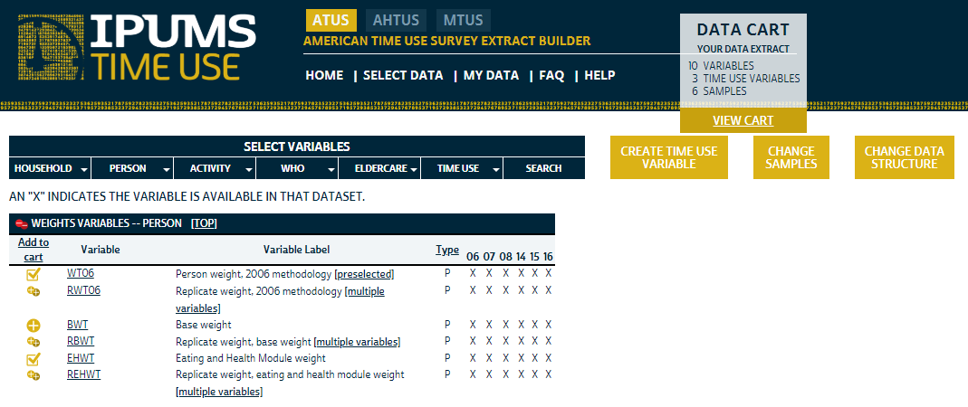

Slide 70
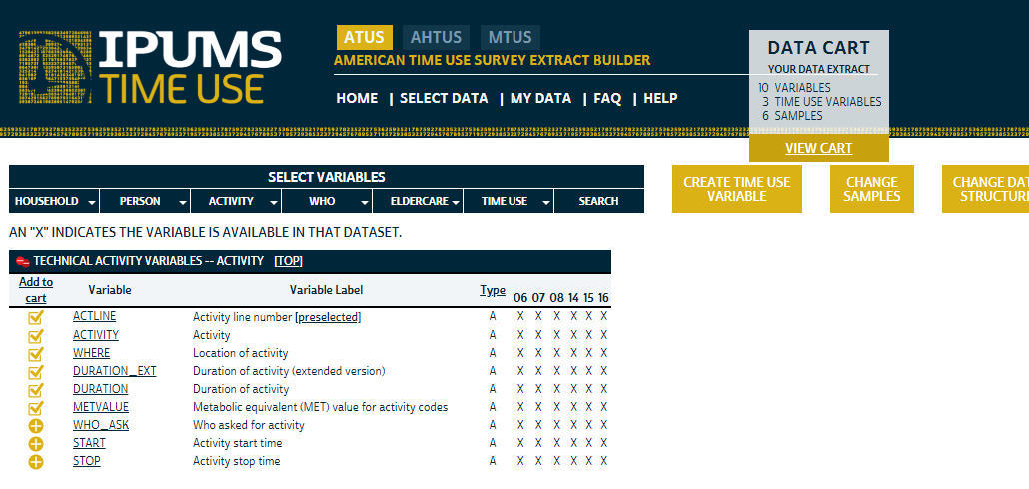

Slide 71
Caution
You cannot select technical activity variables for your file unless you select the rectangular (activity) or the hierarchical option for the file structure. You will be reminded and get the option of changing your structure.
If you wish to use a rectangular (person) file structure you will have to create all your time variables within the archive. This will probably be sufficient for most research projects.

Slide 72
The time use variables you should create are:
Time spent in exercise (ACTIVITY=130100)
Time spent in walking or biking as exercise
Time spent walking or biking as a mode of transportation (WHERE=232 or 235)
Time spent in moderate activities (METVALUE>=3 & METVALUE<6)
Time spent in vigorous activities (METVALUE>=6 & METVALUE<999)
Time spent in moderate or vigorous activities

Slide 74
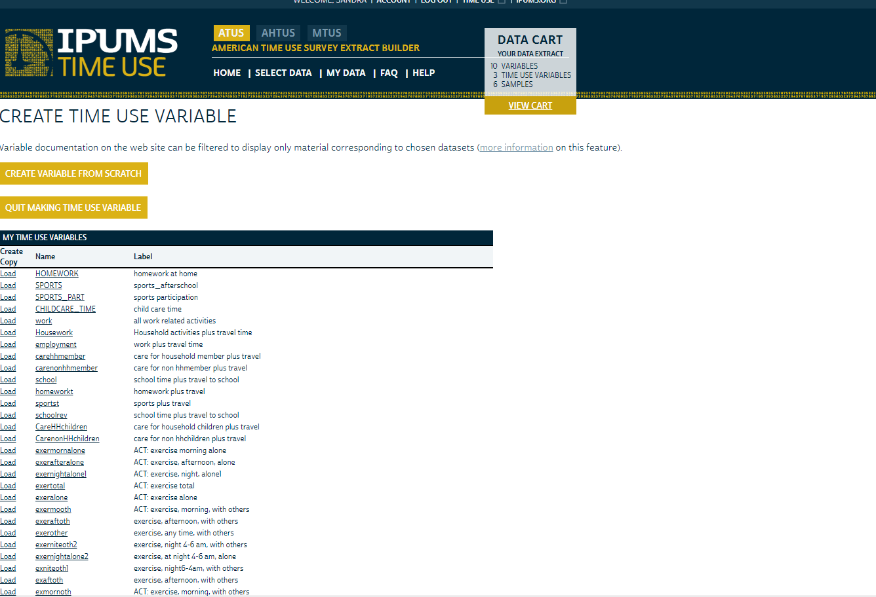

Slide 75
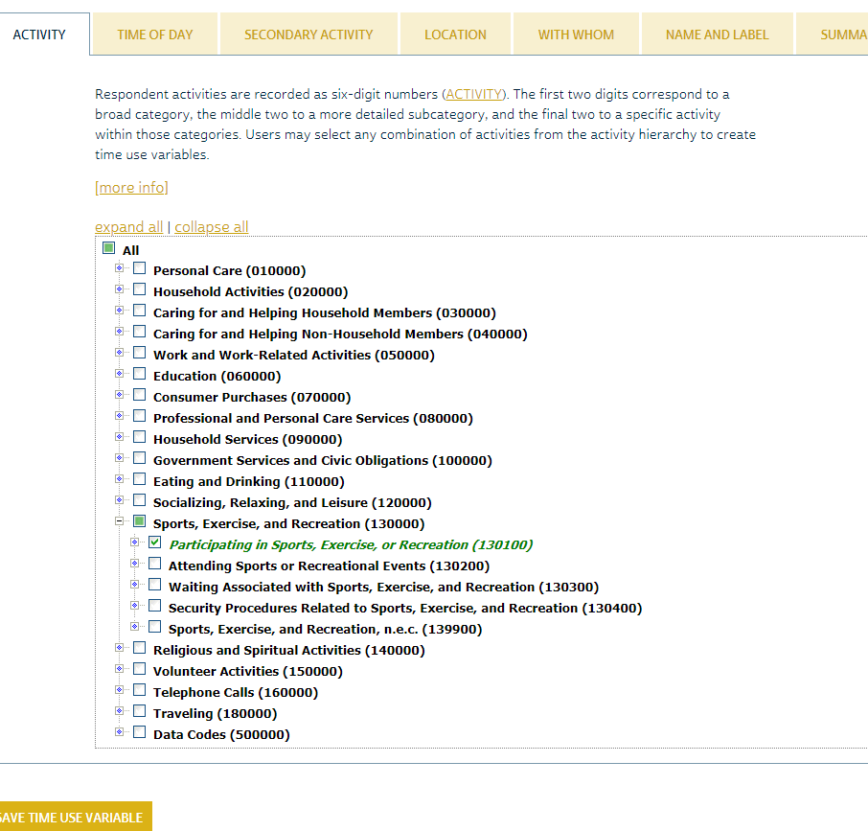

Slide 76
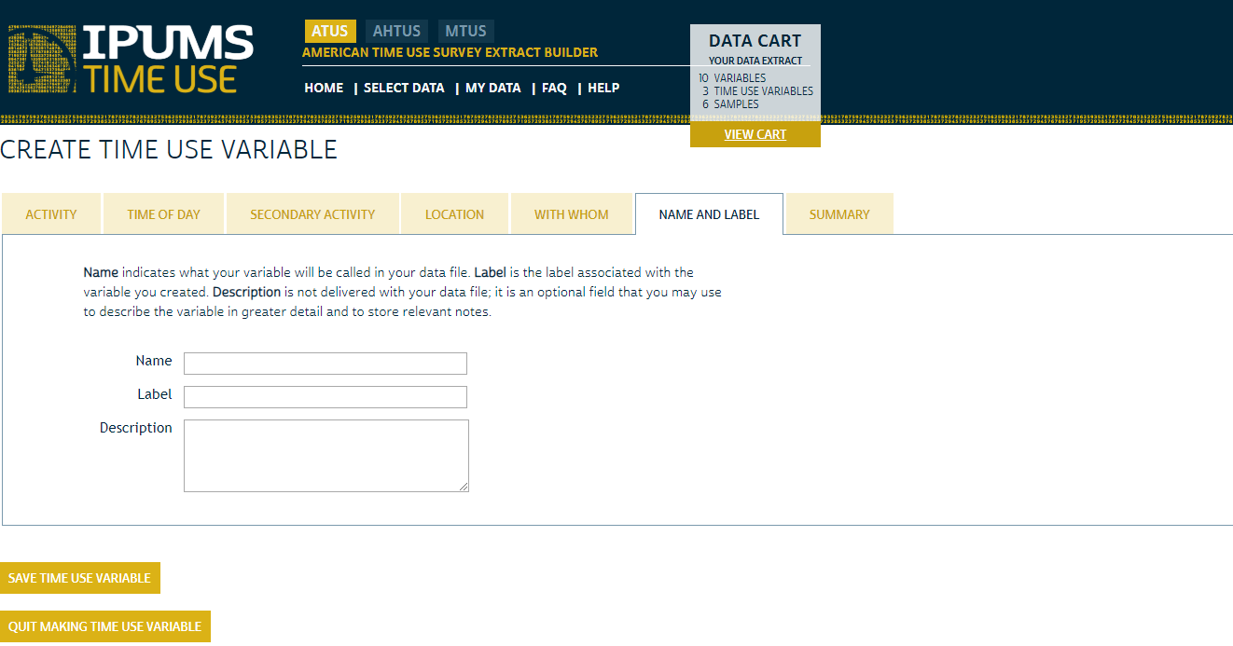

Slide 77
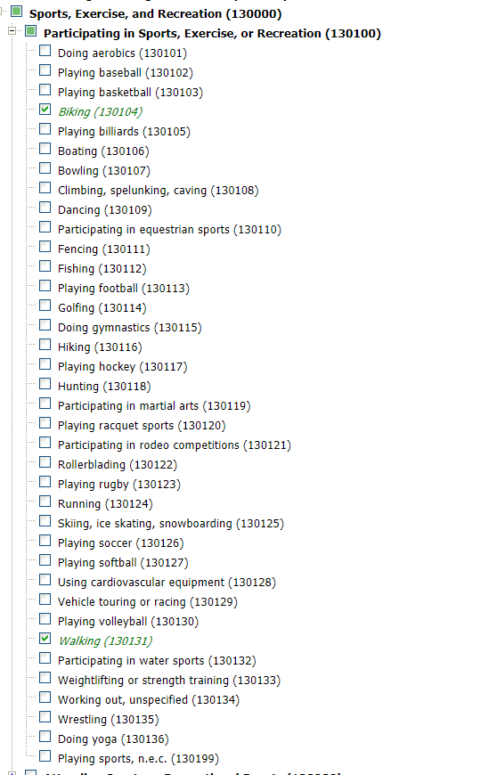

Slide 78
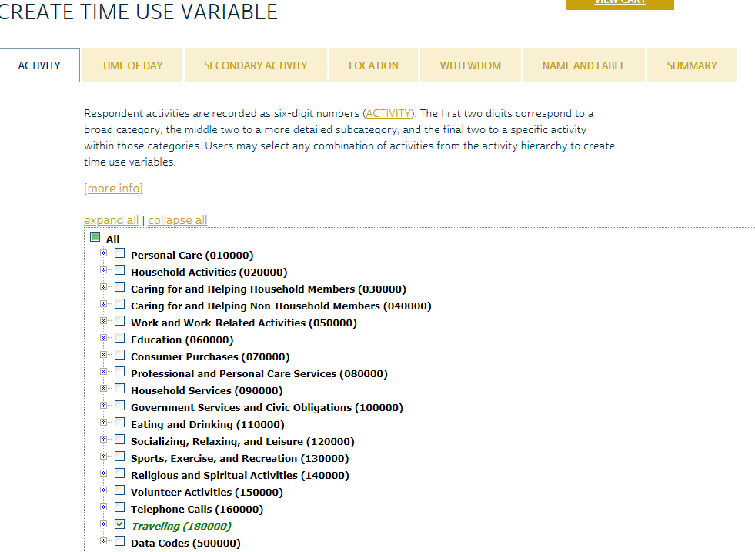

Slide 79
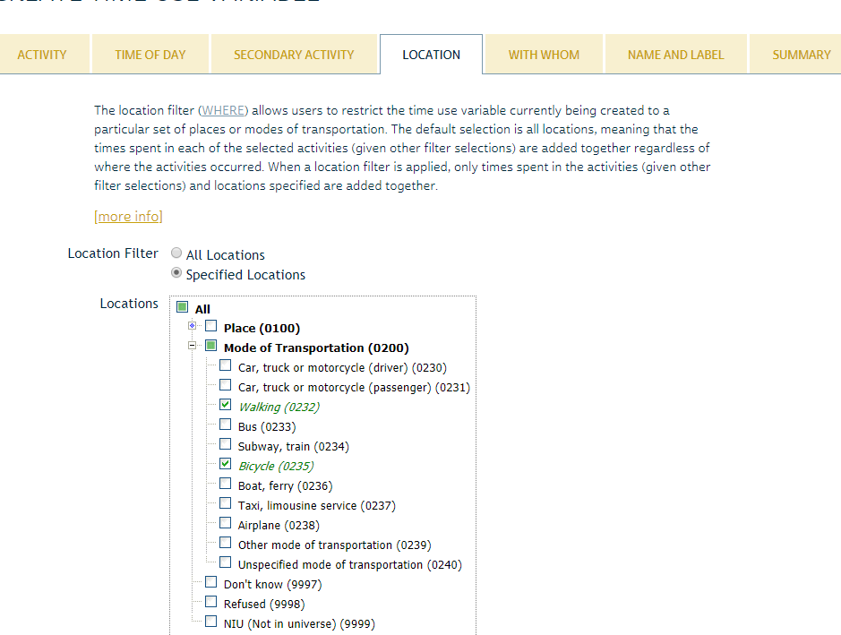

Slide 81
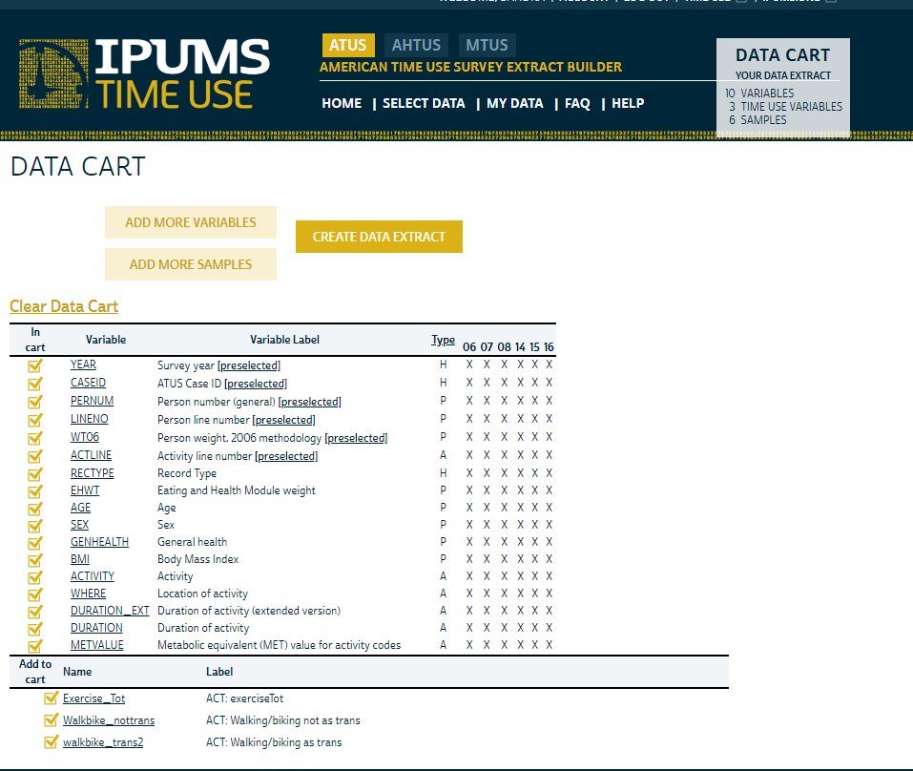

Slide 82
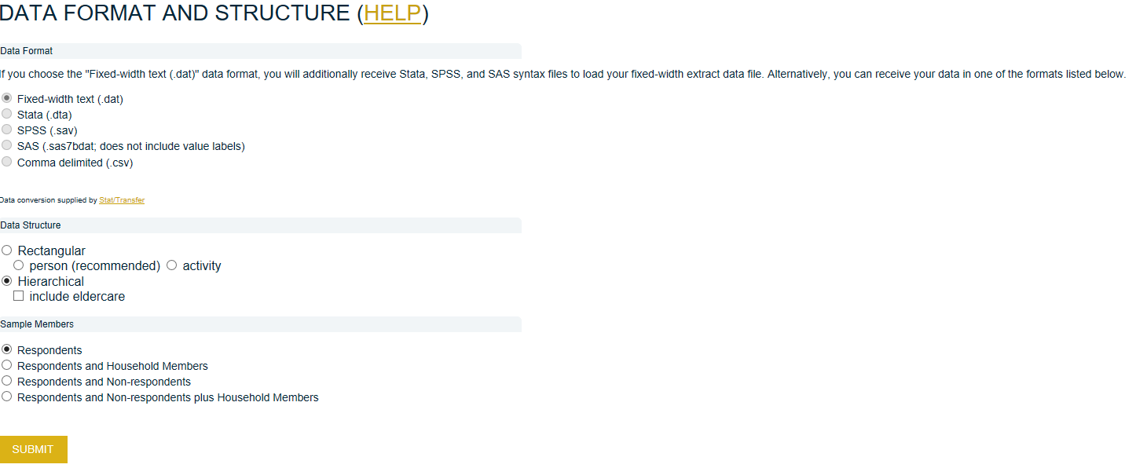

Slide 83
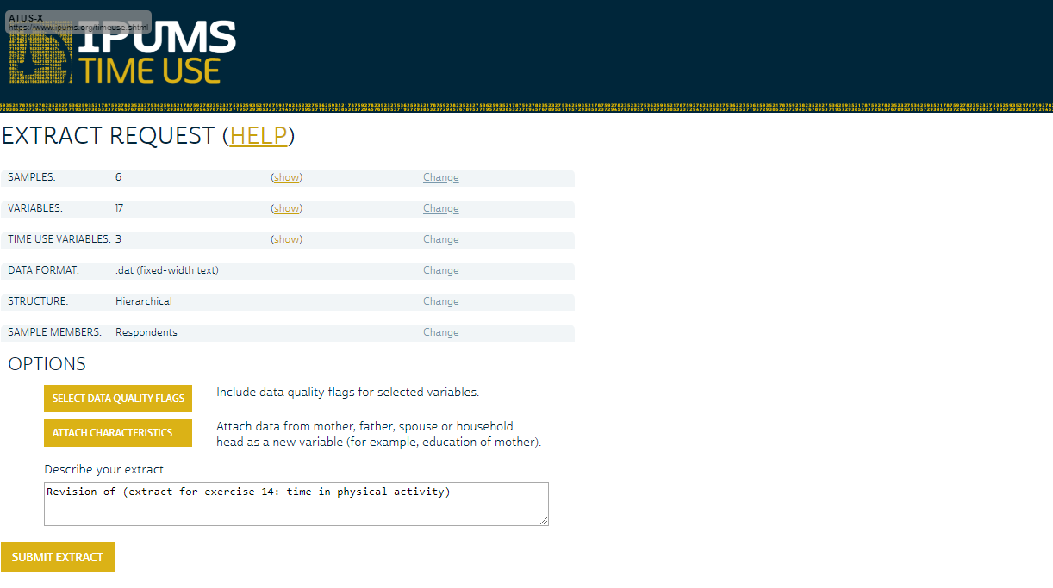

Slide 84
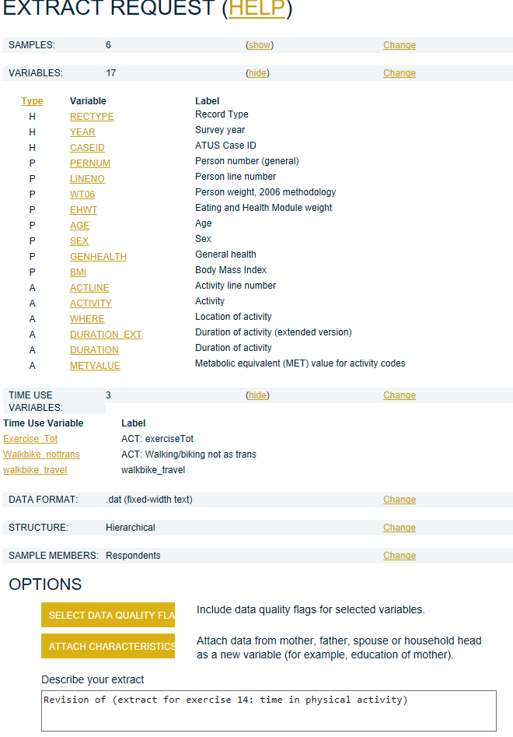

Slide 85
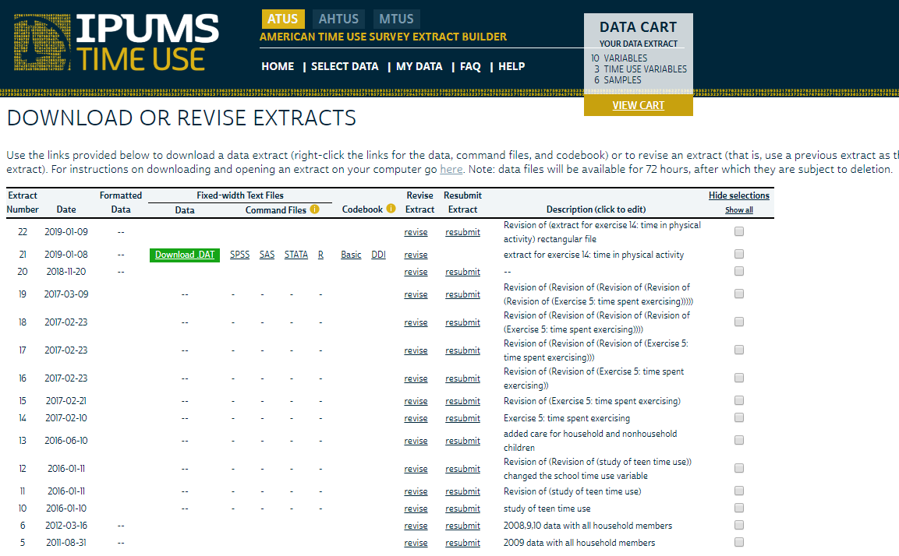

Slide 86
Download and Analyze Data

Slide 87
Next Steps
Download data in text (or statistical software) format and command files in your specific software package (SPSS, SAS, Stata)
Download and copy codebook into Word (landscape)

Slide 88
Create Analytic File
Must first extract your data from its GZ compressed format using zip software such as 7 Zip (free).
Then change the command file program to show where the data file is located and where to deposit the analysis file after it is created.
Instructions are on the IPUMS web site:
https://www.atusdata.org/atus/extract_instructions.shtml

Slide 89
Analysis Strategy
Use SAS, Stata, or SPSS to recode and analyze data
Guides for using SAS, Stata, SPSS to create time diary variables are available at bottom of page: https://www.atusdata.org/atus/training_materials.shtml
For specific SAS and STATA codes for this exercise, see workshop answers for exercise 7.
We will be happy to spend time showing how to run specific analyses for exercise 7 in another session or one-on-one sessions

Slide 90
Types of Data
Rectangular (default)
Hierarchical
Preferred by most researchers
Ready to analyze
Person records ONLY
Activity and Who record information is used to create time use variables—you never actually see them
RECTYPE Record Type
1 H
2 P
3 A
4 W
5 R
Five record types
Household, Person, Activity, Who, Elder care recipient
Select variables for each record type if you want them to be included
More difficult to work with, but better for creating LOTS of time use variables that are only slightly different or are too complicated to do in the system
Necessary for analyzing activity sequences
Notes:
TUV correspond with the total time spent by the person in the variable created

Slide 91
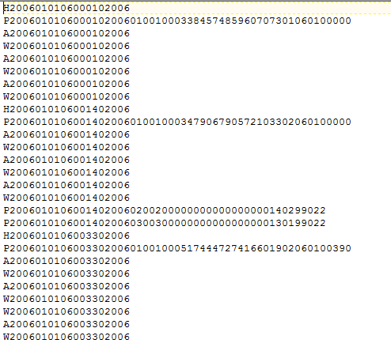
Hierarchical Data: What they Look Like
Back
Notes:
After selecting samples and the type of the data you can select the variables you want in your extract
Variable are grouped in categories
You can see for which samples of your selection the variable is available
Choose region and the age of the youngest child.
Introduce cps8

Slide 92
Basic Person Record for all Household Persons
Reading each record (order of main vars will vary depending upon your statistical package)
Record type 1
Year 2-6
CaseID 7-20 (last 4 digits are year)
Person number 21-22
Line number 23-25
Weight 26-42

Slide 93
Hierarchical File
Strategy:
1. Divide the hierarchical file into two:
the person records and
All activity records.
Create new time diary variables that summarize daily time for each person that meet specific MET criteria.
Merge the now person-specific time diary variables with the person record for each person.
Recode the demographic and health variables and conduct means (weighted by EHWT) of exercise and physical activity time by categories of self-reported health and BMI to summarize data.

Slide 94
Rectangular Data: What they Look Like

Slide 95
Rectangular/Activity file
1. Create new time diary variables that meet specific MET criteria to summarize daily moderate/vigorous time for each person over all their daily activities. Retain demographic and health variables.
2. Retain one record per person.
3. Recode the demographic and health variables and conduct means (weighted) of exercise and activity time by categories of self-reported health and BMI to summarize data.

Slide 96
Exercise 7. Minutes Per Day Spent in Physical Activity by BMI and Health, 2006-08, 2014-16
BMI |  | Total Exercise | Exercise: Walking, Biking | Transportation: Walking, Biking | Moderate Activities | Vigorous Activities | Moderate or Vigorous Activities | N
 | Underweight | 20.2 | 3.9 | 4.1 | 47.2 | 10.2 | 57.4 | 1,764
 | Normal | 24.6 | 5.0 | 3.9 | 84.0 | 7.3 | 91.2 | 22,685
 | Overweight | 19.2 | 4.7 | 2.5 | 94.1 | 3.9 | 98.0 | 23,124
 | Obese | 14.1 | 2.6 | 1.6 | 90.8 | 2.3 | 93.2 | 15,819
 | Extremely Obese | 13.5 | 4.0 | 3.5 | 82.6 | 3.0 | 85.6 | 6,488
General Health Status
 | Excellent | 30.9 | 5.2 | 4.1 | 89.9 | 9.6 | 99.4 | 12,747
 | Very Good | 23.4 | 5.2 | 2.5 | 90.0 | 5.4 | 95.5 | 23,523
 | Good | 3.2 | 3.8 | 2.3 | 90.2 | 2.3 | 92.5 | 21,260
 | Fair | 8.7 | 3.2 | 2.8 | 83.0 | 2.3 | 85.3 | 8,612
 | Poor | 7.3 | 3.0 | 4.6 | 42.5 | 0.4 | 42.9 | 2,941

Slide 97
Acknowledgements
This project was made possible through funding from the Eunice Kennedy Shriver National Institute of Child Health and Human Development, Grant No. R01-HD053654-12

Slide 98
Want More? https://www.atusdata.org/atus/training_materials.shtml
Thanks for your participation!
Questions can be sent to Hofferth@umd.edu, Lsayer@umd.edu or IPUMS@umn.edu

Slide 99
Acknowledgements
This project was made possible through funding from the Eunice Kennedy Shriver National Institute of Child Health and Human Development, Grant No. R01-HD053654-12

